Slide 1

CLR(Common Language Runtime)

Slide 2
Common Language Runtime(CLR)
The Common Language Runtime (CLR) is a component of the Microsoft .NET Framework that manages the execution of .NET applications.
It is responsible for loading and executing the code written in various .NET programming languages, including C#, VB.NET, F#, and others.
The CLR provides many services to .NET applications, including memory management, type safety, security, and exception handling. It also provides Just-In-Time (JIT) compilation, which compiles the CIL code into machine code.
Overall, the CLR is a critical component of the .NET Framework and is responsible for ensuring that .NET applications are executed in a safe, secure, and efficient manner.

Slide 3
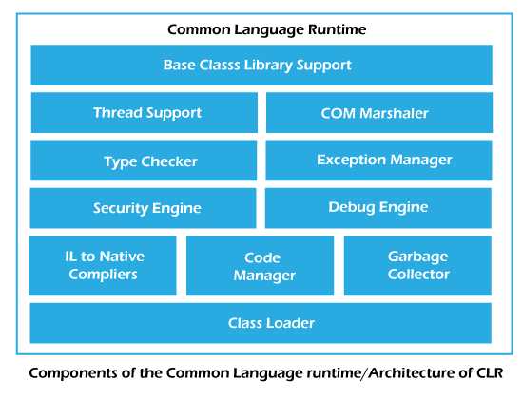
Features of CLR

Slide 4
Base Class Library Support
The Base Class Library (BCL) is a sub-part of the framework that provides library support to common language runtime. And it is primarily developed by using C# language.
The Base Class Library is also known as .Net Framework Class Library (FCL).
The Base Class Library (BCL) has a rich collection of library features and functions. And the main specialty of this library is that it can be consumed by any .NET language.
USAGES :
i) BCL is the main point of interaction between the developers and runtime.
ii) This library provides the namespaces that are frequently used.

Slide 5
Thread Support
It manages the parallel execution of the multi-threaded application.
By utilizing the thread pool, managed applications can efficiently handle concurrent tasks.
COM marshaling is a mechanism within Component Object Model (COM) that facilitates communication between objects residing in different apartments.
COM supports features such as object instantiation, method invocation, and interface-based communication.
It provides a mechanism for creating reusable software components that can be used across different languages and platforms.
COM Marshaler

Slide 6
Type Checker
Type checking is the process of verifying and enforcing constraints of types in values.
A compiler must check that the source program should follow the syntactic and semantic conventions of the source language and it should also check the type rules of the language.
The type-checker determines whether these values are used appropriately or not.
It checks the type of objects and reports a type error in the case of a violation, and incorrect types are corrected. Whatever the compiler we use, while it is compiling the program, it has to follow the type rules of the language.
Every language has its own set of type rules for the language.

Slide 7
Exception Manager
The Exception Manager in the CLR (Common Language Runtime) is responsible for handling and managing exceptions that occur during the execution of .NET applications.
It provides a structured mechanism for catching and handling exceptions, preventing the application from crashing.
It supports try-catch blocks and other exception handling constructs to ensure proper error handling and recovery.
The exception manager plays a crucial role in maintaining application stability and facilitating robust error handling in the CLR environment.

Slide 8
Security Engine
The security engine in the CLR (Common Language Runtime) is responsible for enforcing security policies and providing a secure execution environment for .NET applications.
It provides mechanisms for code and data verification, ensuring that code operates within a trusted and secure context.
Overall, the security engine enhances the security of .NET applications, protecting against unauthorized access and malicious code execution.

Slide 9
Debug Engine
The debug engine in the CLR (Common Language Runtime) is responsible for supporting debugging functionalities during the development and testing of .NET applications.
The debug engine enables developers to track and diagnose issues within their code, facilitating the identification and resolution of bugs.
It works in conjunction with debugging tools, such as Visual Studio, to provide a comprehensive debugging experience for .NET applications.
Overall, the debug engine plays a crucial role in the software development process for detection and resolution of programming errors.

Slide 10
Code Manager
In the CLR (Common Language Runtime), the code manager is responsible for managing the execution of .NET code.
It performs tasks such as just-in-time (JIT) compilation, converting Intermediate Language (IL) code into machine code at runtime.
The code manager also handles memory allocation for the compiled code and manages its execution within the runtime environment.
It ensures proper execution order and handles exception handling and debugging functionalities.
Overall, the code manager plays a vital role in executing and managing .NET code within the CLR.

Slide 11
Garbage Collector
The garbage collector in the CLR (Common Language Runtime) is responsible for automatic memory management in .NET applications.
It identifies and frees up memory that is no longer in use, reclaiming resources and preventing memory leaks.
The garbage collector tracks object references and determines which objects are still reachable and which can be safely deleted.
It runs in the background, periodically performing garbage collection to release unused memory and improve application performance.
The garbage collector reduces the burden of manual memory management, making .NET programming more efficient and less prone to memory-related errors.

Slide 12
Class Loader
In the CLR (Common Language Runtime), the class loader is responsible for loading and initializing .NET classes and types.
It locates and loads the required assembly files containing the classes needed by a .NET application.
It performs type verification, ensuring that the loaded types adhere to the rules of type safety.
The class loader also handles assembly resolution, managing dependencies and resolving references to other assemblies.
It plays a crucial role in the overall execution and management of .NET applications within the CLR environment.

